Slide 1
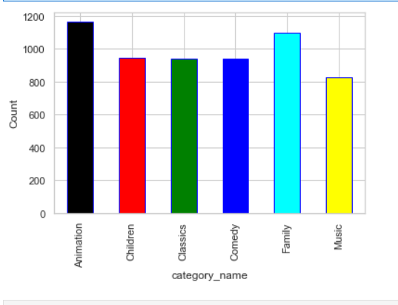
What is the most watched movie category?
It is obvious from this visualization that Animation category movies are the most-watched movie.

Slide 2
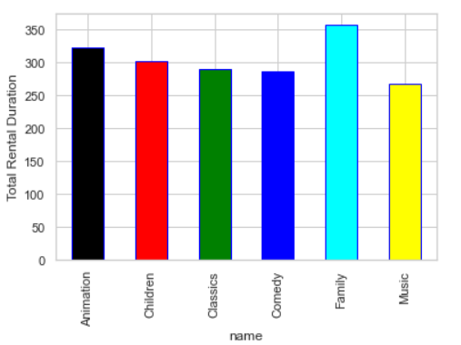
How the length of rental duration of these family-friendly movies compares to the duration that all movies are rented for?
It is obvious from this visualization that that family movies has a longer duration that leads to the longest rental duration

Slide 3
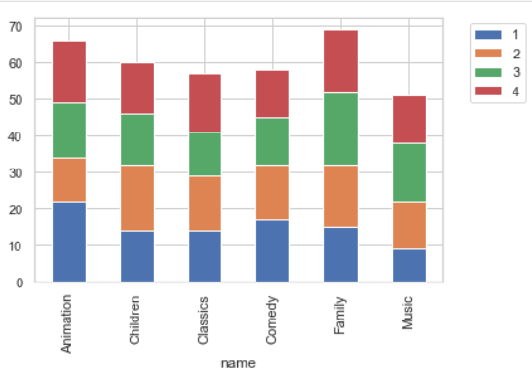
provide a table with the family-friendly film category, each of the quartiles, and the corresponding count of movies within each combination of film category for each corresponding rental duration category.
It is obvious from this visualization that for:
Movies with short duration are animation.
Longest movies are in family category

Slide 4
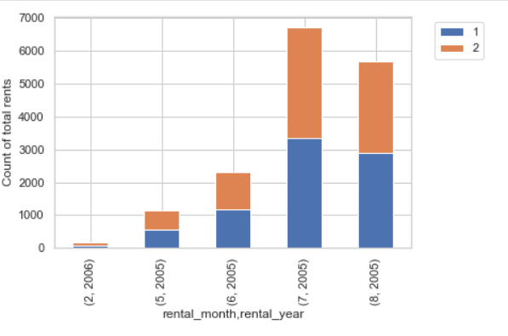
We want to find out how the two stores compare in their count of rental orders during every month for all the years we have data for.
It is obvious from this visualization that July of the year 2005 was the most trafficked month of movie rentals.

